Slide 1



fullstackdatascience.com
Lesson 9 - Data Modeling
and DAX
Power BI
Created by Huydata
DA K6
Lesson 3
huynt@fullstackdatascience.com
1

Slide 2

Learn
About
01/
Data Modeling
02/
DAX
03/
Lab
fullstackdatascience.com
2

Slide 3

Data Modeling
Data modeling in Power BI is essential because it helps transform raw data into a structured, meaningful format that enables efficient analysis, visualization, and reporting.
3

Slide 4
Why Data Modeling matters?
Better Performance
Relationships Between Tables
Accurate Calculations
Reusability
Flexibility and Customization
Supports Star Schema (Best Practice)
5

Slide 5
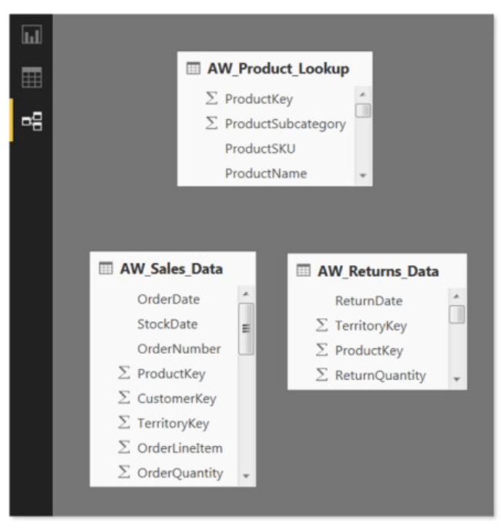
What is Data Modeling
This is not a data model
This is a composite of independent tables,
with no relationships.
Q: Try creating a table with Product column in DimProduct and SalesAmount column in FactResellerSale?
5

Slide 6
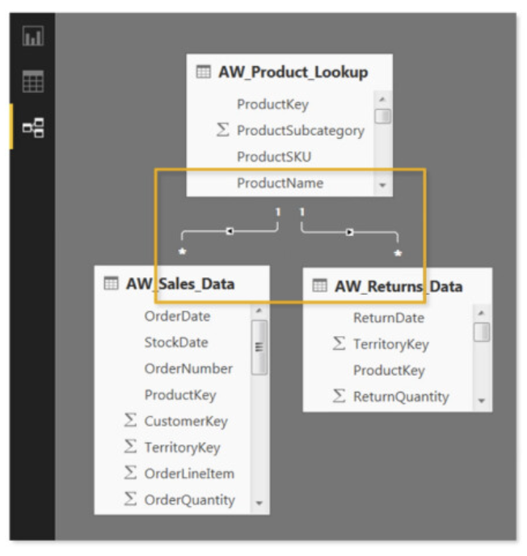
What is Data Modeling
This is a data model
Tables are connected to each other by relationships through PKs and FKs.
Q: Try creating a table with Product column in DimProduct and SalesAmount column in FactResellerSale?
5

Slide 7
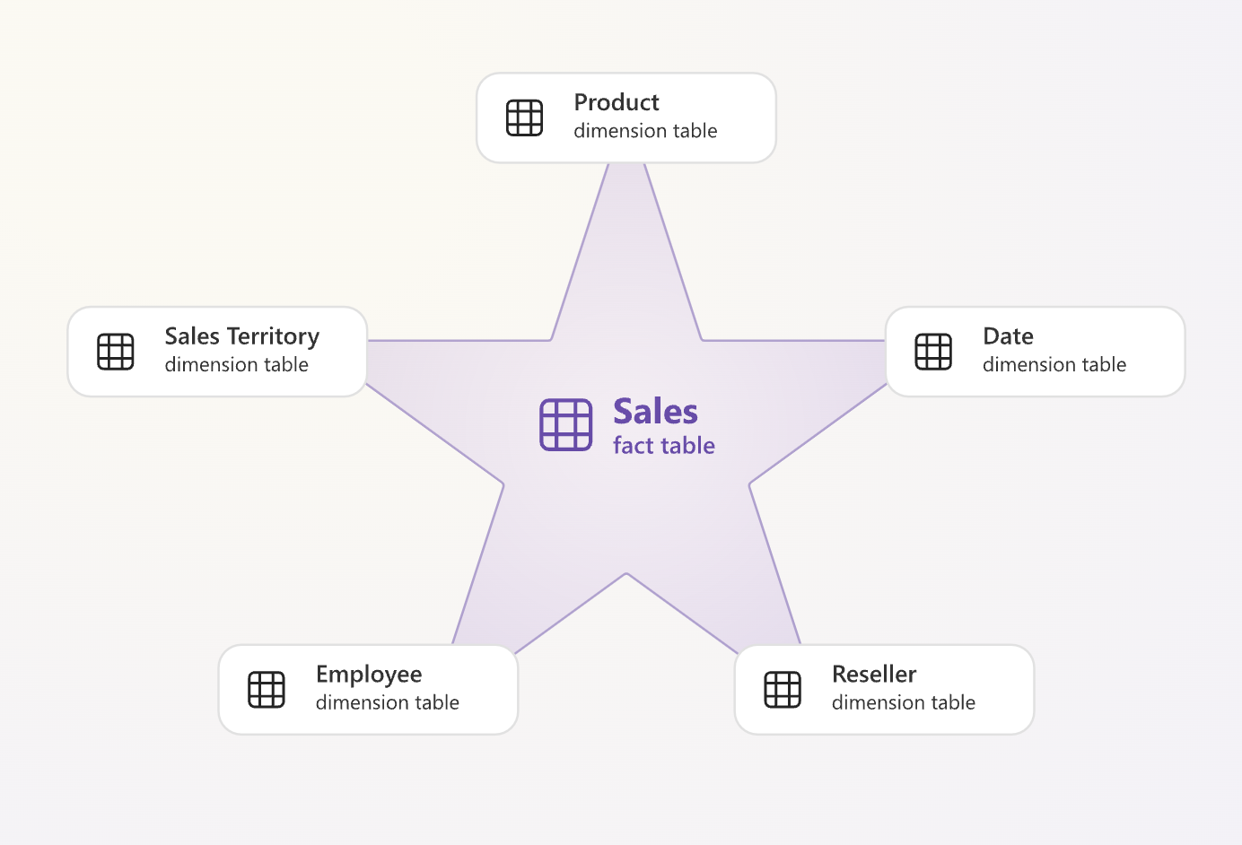
Star Schema
Fact tables store observations or events, and can be sales orders, stock balances, exchange rates, temperatures, and more.
A fact table contains dimension key columns that relate to dimension tables, and numeric measure columns.
The dimension key columns determine the dimensionality of a fact table, while the dimension key values determine the granularity of a fact table.
Dimension tables describe business entities—the things you model. Entities can include products, people, places, and concepts including time itself.
https://dataedo.com/samples/html/Data_warehouse/doc/AdventureWorksDW_4/home.html
5

Slide 8
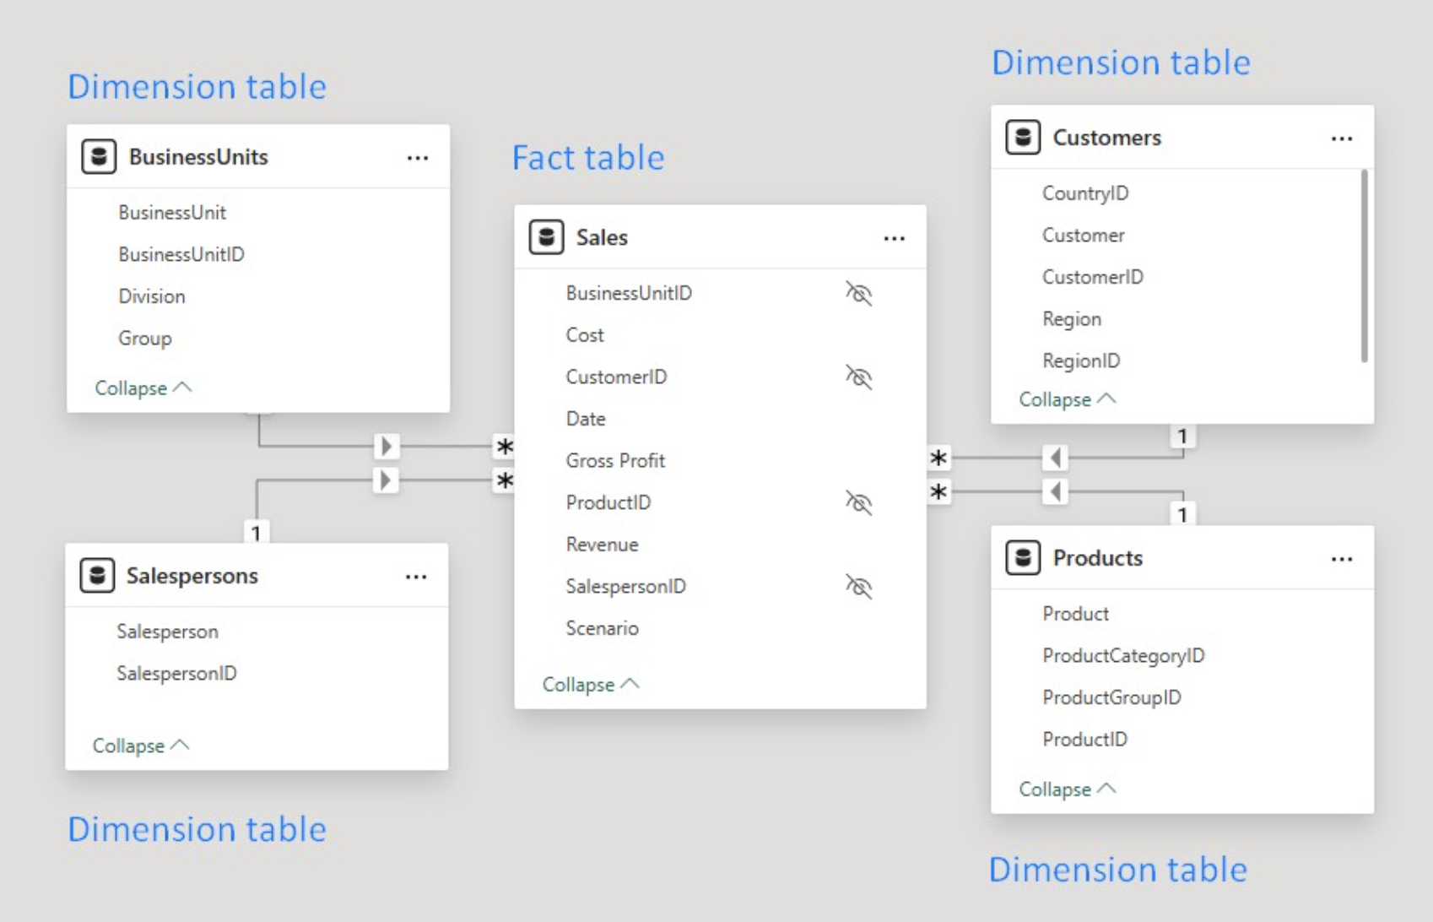
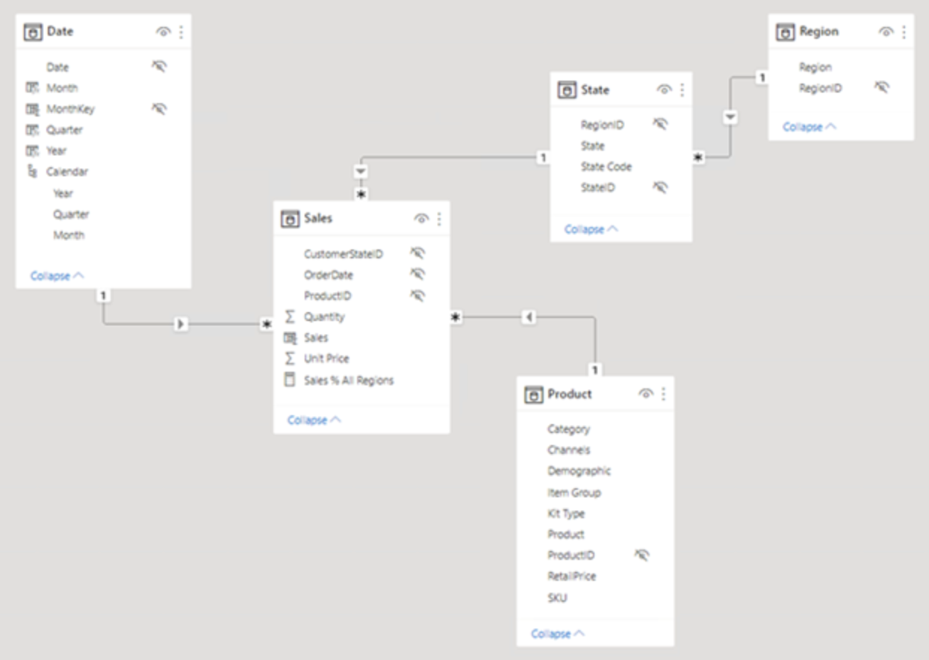
Example of Star Schema
5

Slide 9
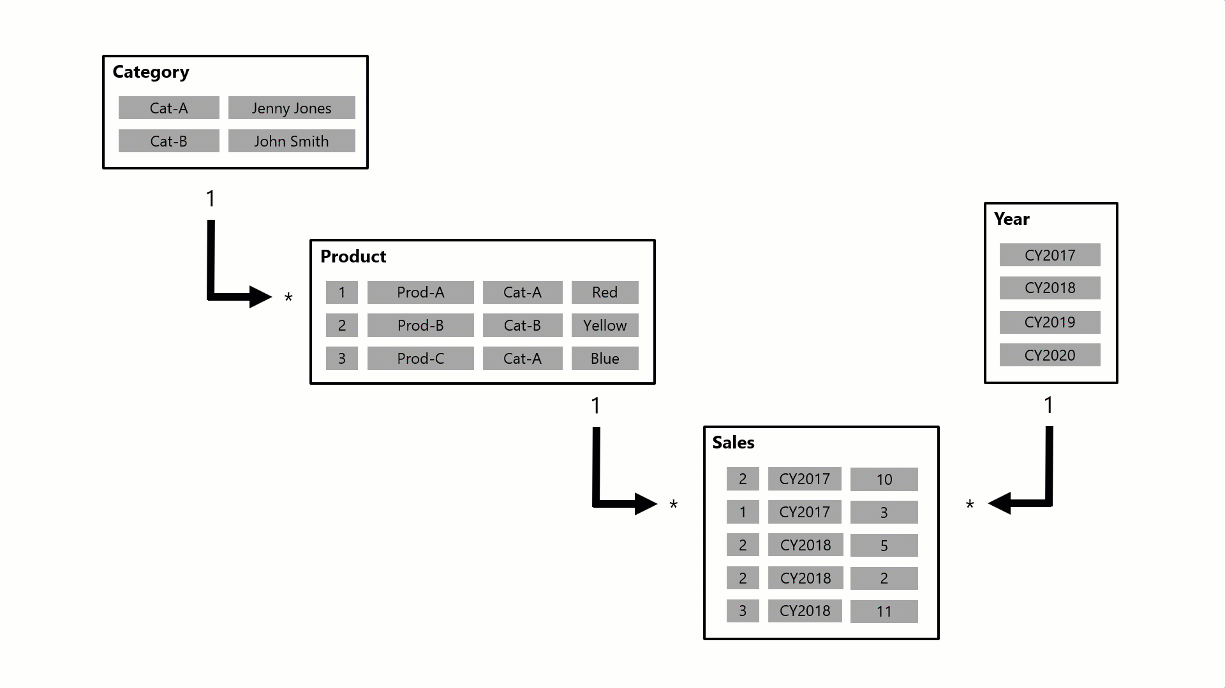
Relationship Purpose
5

Slide 10
Cardinality
The four options, together with their shorthand notations, are described
in the following bulleted list:
One-to-many (1:*)
Many-to-one (*:1)
One-to-one (1:1)
Many-to-many (*:*)
5

Slide 11
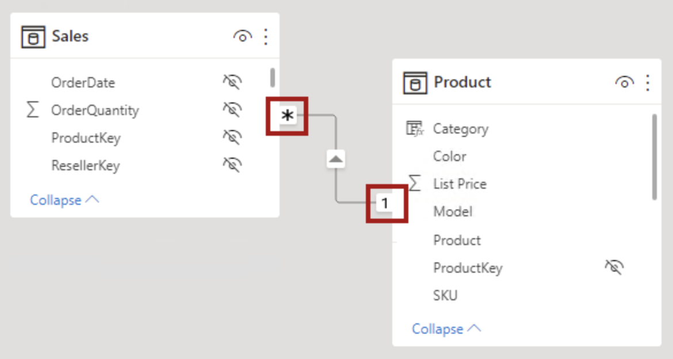
One-to-many (and many-to-one)
5

Slide 12
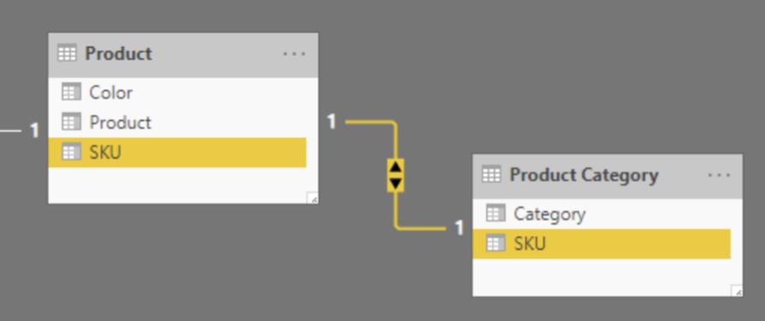
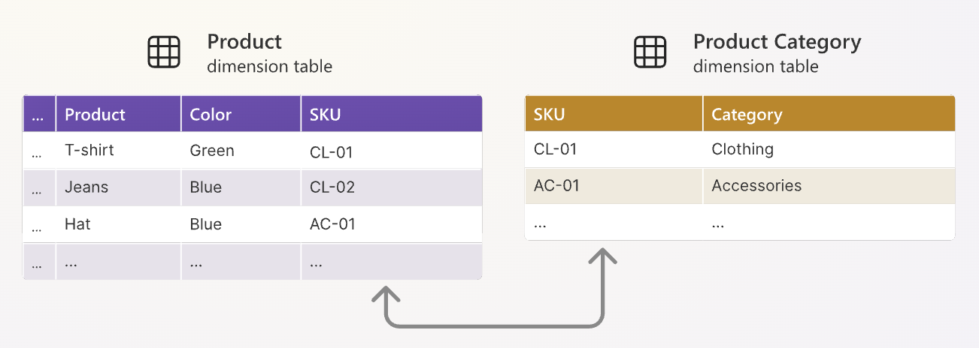
One-to-one
A one-to-one relationship means both columns contain unique values. This cardinality type isn't common, and it likely represents a suboptimal model design because of the storage of redundant data.
5

Slide 13
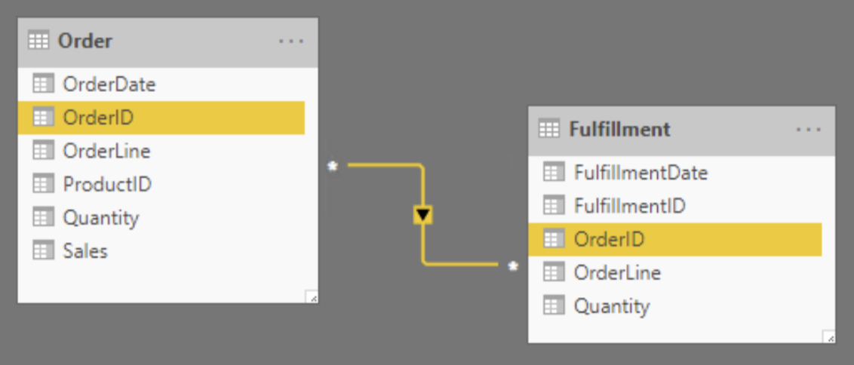
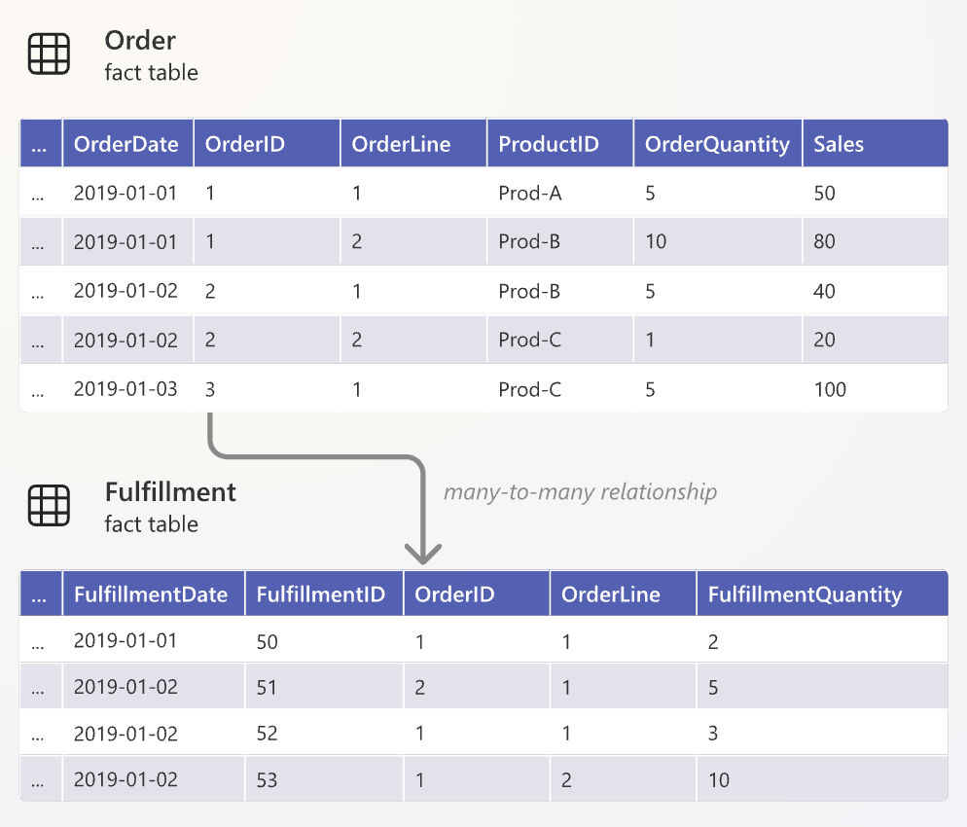
Many-to-many
Rows in the Fulfillment table represent order items that have been shipped
5

Slide 14
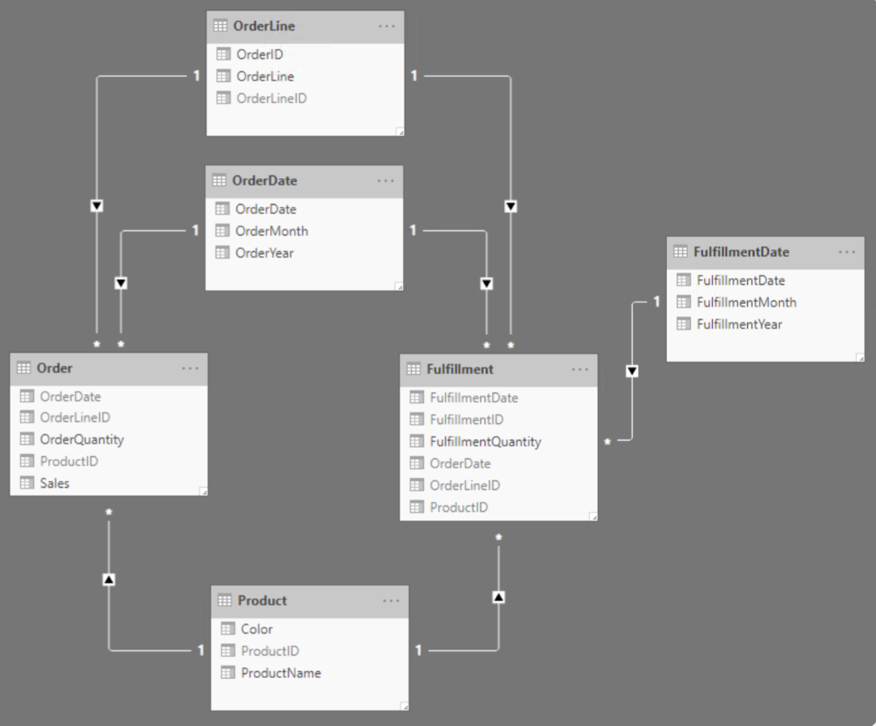
Many-to-many
A many-to-many relationship means both columns can contain duplicate values. This cardinality type is infrequently used.
5

Slide 15
Practice 1
Create a relationship between the DimProduct, DimProductCategory, FactResellerSale tables and then draw a Table Chart showing SalesAmount by each CategoryName
Think about creating relationships between the remaining tables (Refer to dictionary)
Create a measure that calculates the total Profit (Hint: Use the sum function, and the relevant columns in the FactResllerSales table)
Drag the Profit column into the table created from Task 1. And calculate the Profit Margin index and drag it into the table as well.
5

Slide 16
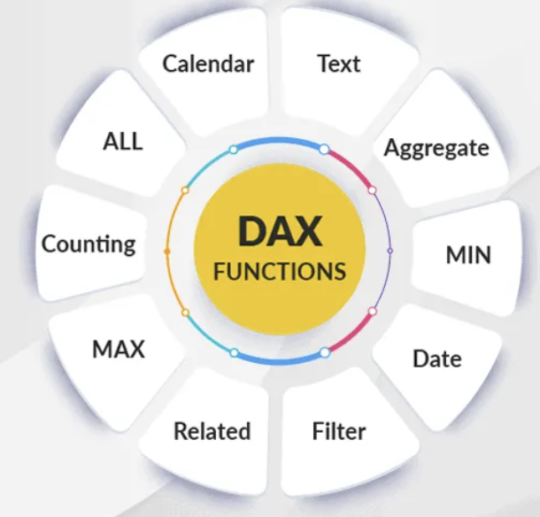
DAX
DAX stands for Data Analysis Expressions.
3

Slide 17

Why is DAX important?
DAX helps you answer business questions like:
What is the total revenue this month?
Which product has the highest sales growth?
How many active users did we have compared to last year?
What is the conversion rate per campaign?
With DAX, you can transform raw data into insights
5

Slide 18
What is DAX?
DAX stands for Data Analysis Expressions.
It’s a formula language used in Power BI, Power Pivot, and SSAS to:
Create calculated columns
Create measures (metrics)
Build custom tables
Perform advanced calculations and data analysis
Think of it like Excel formulas — but much more powerful, especially for large datasets and complex data models.
5

Slide 19
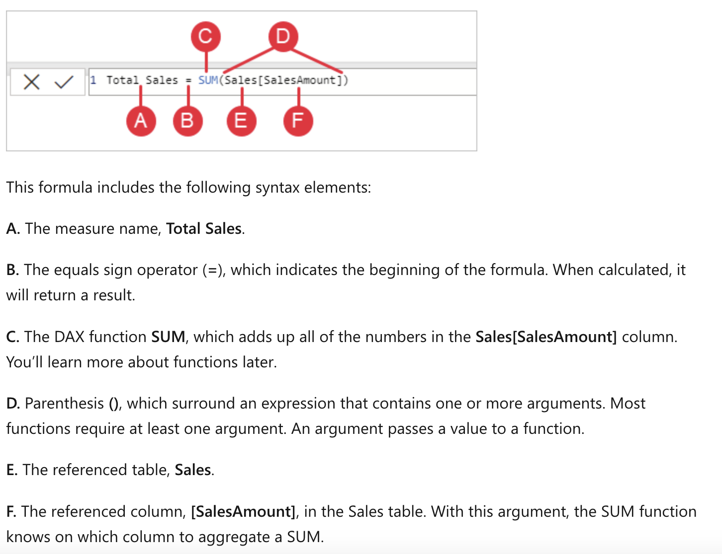
DAX Formula
5

Slide 20
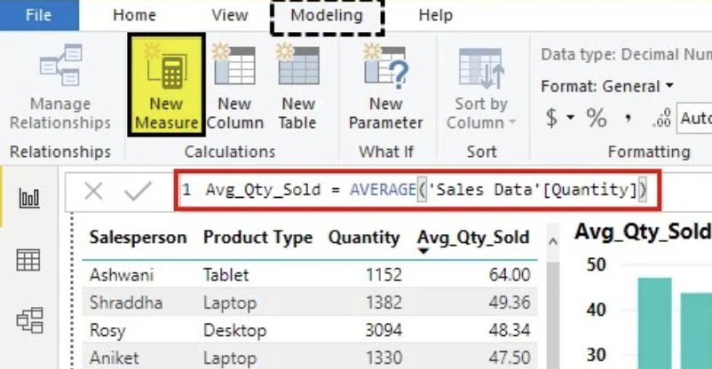
Measure
To define aggregate calculation of data
5

Slide 21
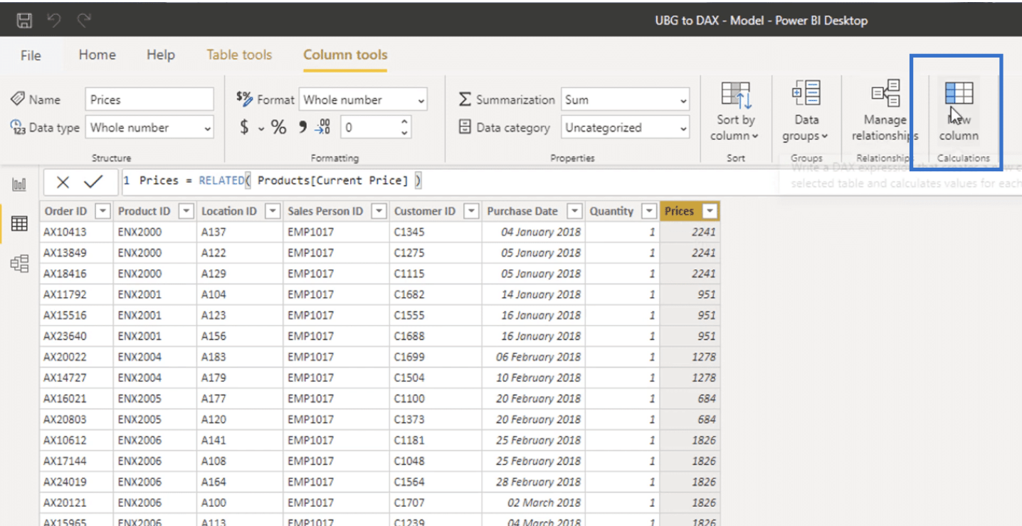
Calculated Columns
To create a value for each row in a table.
5

Slide 22
Practice 2
Create measures to calculate statistical values ​​about Price (In FactResellerSales table): Average, median, min, max and drag into table chart to show price values ​​(min, max, avg, median) by Productkey
Create a measure to count the number of orders (Using the FactResellerSales table)
5

Slide 23

fullstackdatascience.com
References
https://dataedo.com/samples/html/Data_warehouse/doc/AdventureWorksDW_4/home.html
11

Slide 24





Thank you
096 574 90 25
CREATED BY
Nguyen Tien Huy
info@robusto.ai
fullstackdatascience
huynt@fullstackdatascience.com
Data Manager
https://fullstackdatascience.com/
Hanoi, Vietnam

